Slide 2
IOT Connectivity
Nick Dodd

Slide 3
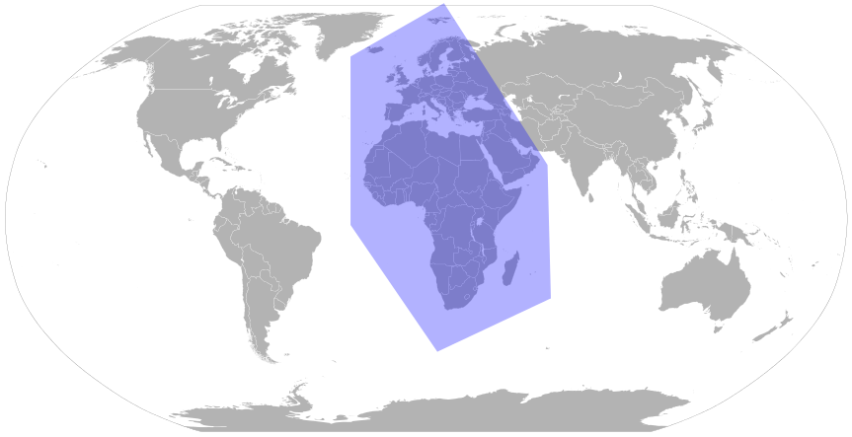
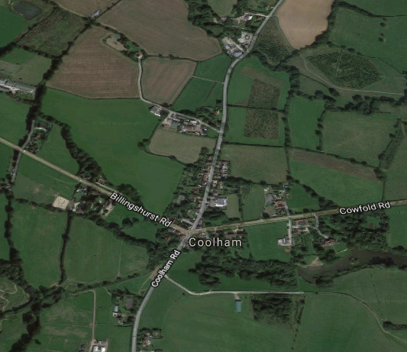
Introduction
Notes:
Hello
Thank you for attending. First to introduce myself, my name in Nick Dodd and a developer in the tridium emea team. Prior to Tridium and the IOT world I spent 10 years practising my Java skills in various other industries such as Oil&Gas and online Bingo. We will talk quite a bit about scaling technologies in this session, which is apt because at the Tridium Emea office we provide tridium sales and support to nealy 1/3 or the worlds population or 2.2 Billion potential customers from a quiet Barn in the English countryside. That is what I call scaling.

Slide 4
IOT Ecosystem
IOT Protocols
Niagara MQTT Driver
Use case
Notes:
The purpose of this topic today is to explore and talk a bit about the fast growing world of web and IOT protocols 3 of the interesting ones which are emerging, and require consideration. We will be looking at a few of these in a little bit of depth and seeing what conclusions we can draw about their relative merits and the contexts in which you would expect to deploy them. As even if you are not a developer or product owner, it certainly helps to understand a little about these weird acronyms when you come across them and this talk will hopefully help you to remember which is which. But as some of you may already be aware, Tridium released their MQTT driver recently, and so we will spend some time looking at this new driver and the technology behind it and demonstrating a simple use case for it.

Slide 5
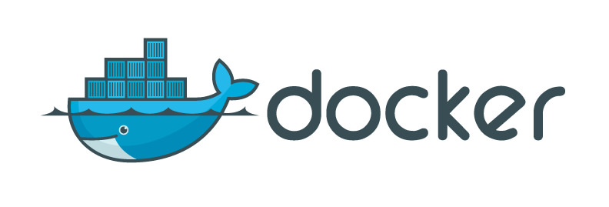
The Age of Microservices
Microservices
Containerized applications
Horizontal scaling
IOT Platforms
Notes:
We are living in a constantly evolving world. When it comes to development, the time of monolithic applications running on application servers, even if these application are clustered is gradually being replaced with the new world of microservices. The new paradigm being that you create very small applications which are designed and built to perform very focused tasks, for example you may create a microservice for servicing just authentication requests from your web page, another which deals with storing data from your devices, another which queries them. Instead of running on an operating system natively – the micro services are launched within containers – little sandboxes which run just the underlying services required to fulfil the needs of your application. For example if your microservice just runs a python application and talks over http – your container will just support the python runtime, your web server of choice and with only the web ports enabled.
These containers run in orchestration platforms such as kubernetes to name one of many. If you find that demand is getting really high on a particular night, your container orchestrator can plug in new instances of your container to meet demand. This is horizontal scaling of applications like stacking containers on a ship, instead of continually adding more resources to your old monolithic application, you increases instances of your small application within the cluster.
In addition to this cloud platforms to host it all, IOT platforms which specialize in managing your device data.

Slide 6
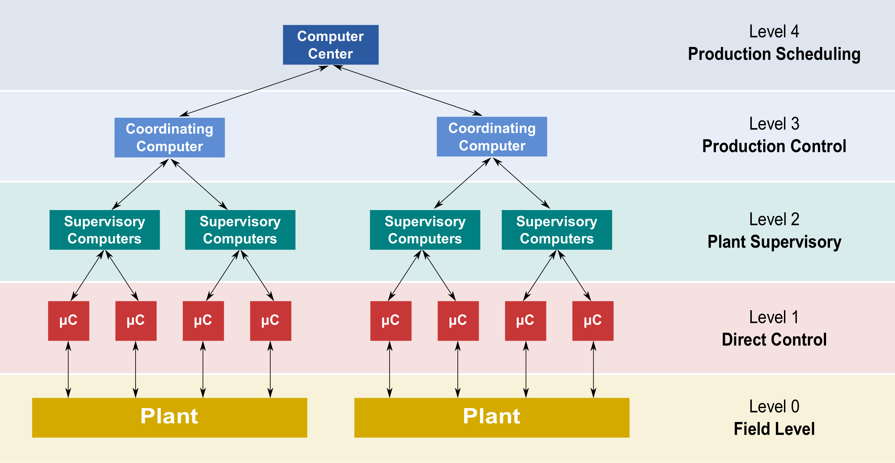
New Challenges
More edge devices
More data
High throughput
Analytics in the cloud
Notes:
How does all this really apply yet to our industry? At the same time in buildings management as we are all aware, there are a lot more edge devices which means a lot more data to sift through, process and perform calculations upon.
In the old view of the world on the right - SCADA control system model as depicted here, the top 2 tiers of this model are becoming ever more suited as candidates for the types of services just mentioned. People will increasingly want vastly more quantities of data in the cloud so that they may perform analysis and feedback on large repositories of data from many sources. To apply the lessons learned in one site to another, refine and iterate. This can be used to compliment rule based analytics running down at the controller / local supervisor level.
The demands of this technology, coupled with the ever growing array of edge enabled devices, calls for a new family of lightweight protocols.

Slide 7
A Plethora of Data Protocols and Technologies
AMQP
LWM2M
Sigfox
Z-Wave
BACnet
M-Bus
SNMP
6LoWPAN
CoAP
Modbus
SOAP
…….
HTTP
MQTT
SSI
HTTP2
Neul
STOMP
JMS
Node
Thread
KAFKA
oBIX
WAMP
LLAP
OpenWire
Websockets
LoRaWAN
OPC
XMPP
LPWAN
REST
Zigbee
Notes:
There exists a mind boggling array of data protocols out there which are compatible with IOT applications and it can sometimes be a headache to get to grips with them. So much so that it was a nightmare to compose this slide as I kept remembering more and having to fix my animations, and I should stress that this is a just a snapshot of some more prominent technologies.
There are many ways to slice the cake – some are based open standards – some are proprietary.
Some are application layer protocols which deliver data on top of transport layer protocols
Some are used to communicate between devices within a building whereas others are designed for wide area networks and beyond
Some are simply part of the http stack of web technologies
We cannot possibly cover all of these in a 45 minute talk, so instead I would like to speak on just a few of these which satisfy a more specific criteria ……..

Slide 8
Lightweight Protocols
Small
Speedy
Steadfast
Scalable
Supported
Secure
Differing goals to traditional Control protocols
Notes:
This is Theresa May the current British Prime Minister. I am not implying she is a lightweight here, and no there was not some bet to get her into my slides. Last year she managed to establish re-election using the punchy political slogan ‘Strong and Stable’. Well IOT protocols are much better than this.
they are small protocols, tiny footprints with very catalogues of commands. Each protocol lets you put whatever binary data you require into the payload of the message allowing you to build your own vendor specific messages, in this respect they are analogous to the Modbus of the control protocol world?
These protocols are efficient – favouring small binary headers, packets in the 10’s of bytes instead of 100s, making them more battery efficient
They survive on unstable networks perhaps over wireless comms. Support methods for self recovery from error conditions, useful on lossy networks
Due to their many to many natures they can scale up beyond the scope of traditional topology, adding more devices does not limit the design
They are based upon non proprietary open standards promoting growth of tooling and reuse the best bits of existing web protocols
They utilize modern authentication technology.
It is important to stress that these protocols are not really competing with your well known control systems such as Bacnet, they serve a different purpose which is more about delivery of data and events from different sources to a remote application, and less about offering a rich structured protocol of functionality for a specific suite of equipment on a given site.

Slide 9
MQTT
The featherweight

Slide 10
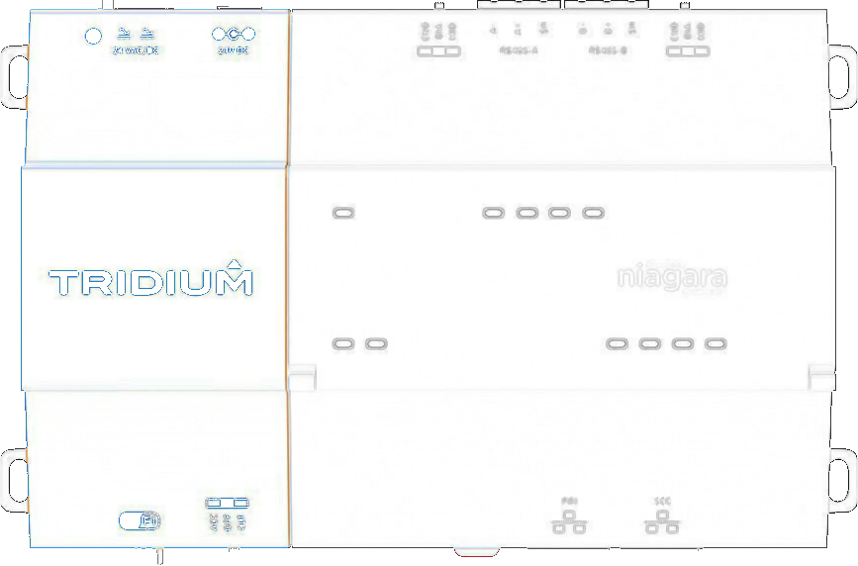
So What is it?
Publish 22º
to /garden/temp
Subscribe to /building1/status
Subscribe to /garden/temp
22º
Message Queue Telemetry Transport
Publish / Subscribe Model with Topics
Central Broker
Binary message payload
{‘oat’:22, floor1: 24, ‘status’: ‘override’} to /building1/status
22º
24º
22º
22º
MQTT
Broker
TCP
Override
IP 4/6
Subscribe to /garden/temp
Subscribe to /garden/temp
Notes:
MQTT is a protocol that was first authored in 1999, its purpose to offer a publish subscribe model for low powered devices. It is TCP/IP based so your devices have ip addresses or hostnames on your network.
The fundamental concept behind it is that you have a central message broker and many clients.
The brokers job is to deliver messages to all the clients which have subscribed to a given topic.
Topics are just names of message queues to which you can subscribe, and you can create them on the fly
The client could be running on your jace, your laptop, your video projector or your very small field device.
Clients may be publishers as seen in light blue here which could be a sensor or field device, subscribers as seen in red and could be a mobile phone app or a controller.
Or of course they can be clients that do both. The MQTT driver for Niagara which we will see later – is both a publisher and a subscriber, it is not a broker.
The message itself has no data type, it is pure binary data which you can fill with whatever your application requires, be that a number to represent the number of windows open, a Boolean to represent occupancy or more complex data such as images or xml.
Let’s run through what this looks like:
Our central broker is running and ready (I can assure you real brokers run at least twice this speed)
we have 3 mqtt clients running on our phone / laptop and jace which all subscribe to the topic /garden/temp
We have a temperature sensor amongst our roses, which is setup to publish to the same topic
As this value arrives at the broker all 3 subscribers are sent this update.
I should apologise for my very British misake in this presentation of using Celsius temperatures instead of farenheit.
If we have some wire sheet logic running on our jace it may respond to this value and set a temperature override.
Another use case is we might have a custom app which visualizes the status of building in a dashboard.
Our mqtt driver on the jace compounds these values and publishes a json string to the broker.

Slide 11
Many possible configurations
Broker on a cloud platform
Local Broker on a supervisor machine
Broker on device
https://pagefault.blog/2017/03/02/using-local-mqtt-broker-for-cloud-and-interprocess-communication/
Wildcard Subscriptions
subscribe to multiple topics e.g /building1/#
Notes:
There is a lot of flexibility in terms of how you might setup your mqtt system
Typically the broker is used to manage messages between clients over the internet and would be running in the cloud or on a server within your company WAN.
However the broker itself does not need to be running online on a remote computer, some people have embedded local lightweight brokers in their devices which in turn talk broker to broker to a cloud application.
A useful feature is something called wildcard subscriptions that lets your clients subscribe to, for example all topics coming out of building1 instead of each room individually. So you could for example have subscribers per floor of your hotel used for triggering control logic, and an extra wildcard subscriber which audits and logs all events.
Your broker may be running on the embedded device itself,
https://pagefault.blog/2017/03/02/using-local-mqtt-broker-for-cloud-and-interprocess-communication/

Slide 12
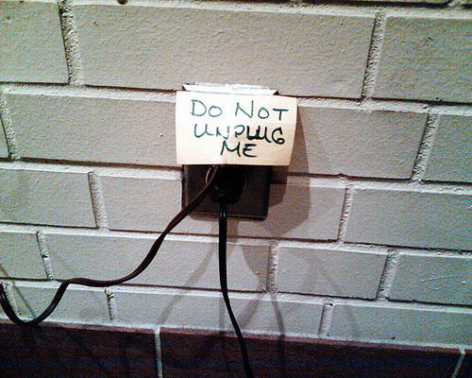
Quality of Service
{“room1”:22.3}
{“room7”:21.4}
{“room3”:24.1}
{“room2”:23.0}
{“room1”:22.3}
3 levels of service available
0 – At most once (zero or one deliveries)
1 – At least once (one or more deliveries)
2 – Exactly once (one delivery)
Persistent Sessions available for levels 1 and 2
use cleanSession=false flag on connection
/building1/temperatures
Notes:
I mentioned earlier that IOT protocols are self recovering and steadfast.
We will briefly look at how mqtt implements this.
MQTT gives you the ability to configure a quality of service level on a connection between client and broker
Level 0 is also known as fire and forget which means we will try at most once to deliver a message and whether it arrives or not…..well life goes on…
This is where some protocols draw the line.
MQTT also lets us say that we want our message to definitely arrive at least once, it might be late but it will get there once, or even more precisely – exactly once – no duplicates.
There is also an optional feature called Persistent Sessions. All messages sent with QoS 1 and 2 will also optionally be queued for offline clients, until they are available again.
So lets say our jace is receiving regular room temperatures via our broker but it set the cleanSession flag when it connected.
Then somebody at IT draws attention to a certain lack of procedure and unplugs the internet.
Now are messages are queued up in the broker and delivered in order once we are back online.

Slide 13
Retained Messages
Add retained to a message
Broker stores the last retained message (and QoS) for that topic
New clients subscribing to that topic received the retained message
{‘occupied’: true}
retain
{‘floor1’: 22.2}
{‘floor2’: 23.3}
/building1/status
/building1/#
/building1/temp
Notes:
Additionally the mqtt protocol allows the concept of a retained message
Each topic has the ability to store a retained message and qos value.
This is no different from any other message apart for the retained flag set to true
Whenever a new client subscribes to that topic it receives the last retained message for the topic. This lets you be defensive in the case of network issues.
An example is our jace is pushing temperature values to the broker, there are no subscribers so these messages are just being ignored.
However when it comes to occupancy data – we have decided it is very important certain actions do not happen when people are in the building. For example when we know the develops office is populated we do not turn off the coffee machines.
So in case we lose internet – we always attach the retained flag to our occupancy message.
Now when a new client comes online and subscribes, it will always know the last good value

Slide 14
Last Will & Testament
CONNECT
LWT: ‘building1 is not online’
/building1/status
{“room1”:22.3}
LWT message sent within the CONNECT message
Handle ungraceful disconnection
Broker stores message
Published to topic if abnormal disconnection
(ping failure & no disconnect)
building1 is not online
building1 is not online
/building1/#
/building1/status
Notes:
MQTT also has the concept of a last will and testament, what on earth does this mean?
Sounds more morbid that it is, this is another technique similar to retained.
This is simply an extra message the client can bundle up in the connect message that says in the event that I stop responding to pings and so I have disappeared of the network without sending a disconnect, publish this message to all subscribers on this topic.
Here we want to let our clients know when building1 is currently unable to service requests
We are happily publishing as normal until oh dear – homer simpson strikes again.
Now the subscribers to our topic are informed of the deceased. You can also set the retained flag on your last will and testament – let new clients know I am offline too when they appear.

Slide 15
Authentication and Security
Username/Password credentials
TLS/SSL with server certificates
with session resumption for efficiency
Clients can prove identity with own X.509 certificate
Authorization governed by the broker
Broker may enforce authorization mapping between client id’s and topics
Separate concerns with multiple brokers
MQTT
SSL
TCP
IP 4/6
Notes:
The most important piece in the puzzle to a lot of people is security.
Mqtt supports username/password based authentication, or you may just transmit a password if your broker uses tokens such as the google iot platform.
In Mqtt v5 – username no longer required
Additionally your network traffic can be encrypted using standard tls with server certificates, and client certificates is also supported.
One important point to note however is that once your client has authenticated with credentials, there is nothing in the current protocol itself to dictate that client x may not subscribe to topic y . This has finally arrive in version 5 of the protocol which the mqtt comittee published on Christmas day last year. If you wish to implement a permissions model before this arrives then perhaps your broker of choice may already have this built in, or you could use different brokers for different clients.

Slide 16
Simple Protocol
CONNECT | CONNACK
PUBLISH | PUBACK
PUBREC | PUBREL | PUBCOMP
SUBSCRIBE | SUBACK
UNSUBSCRIBE | UNSUBACK
PINGREQ | PINGRESP
DISCONNECT
Tiny messages
FIXED HEADER
1/2 Bytes
VARIABLE HEADER
Optional
PAYLOAD
0 Bytes – 128MB
Notes:
The protocol itself is very tiny, just 14 packet types, just connect/disconnect, keep alives, publish/subscribe and some extra for enforcing quality of service level 2. The data packets are typically very small, with only the 1 to 2 byte header being mandatory.
Some message such as the disconnect and ping messages are just 2 bytes in total length, the payload can be up to 128 mb but I should stress most brokers do not support this.
Bear in mind also that your entire message must fit in that payload, there is no message stream - MQTT is not designed for watching netflix
the connect message which is one of the larger headers is typically less than 25 bytes with a short client id.

Slide 17
Libraries and Brokers
Hosted broker Platforms
IBM BlueMix / Node Red
AWS
Microsoft Azure IoT
Google Cloud IoT
Free Clients
mqtt.fx
mqtt-spy
Free test brokers online
HiveMQ
http://test.mosquitto.org/
thingstud.io
Open source brokers
RabbitMQ
Apache ActiveMQ
Mosquitto
Notes:
You may be wondering about the broker itself which is quite an important piece. How would I get one?
Well there are several online test brokers which you can use for free
Additionally there are open source brokers which people have released that you can install on your computer or cloud
There exists some brokers which are hosted for you such as IBM blue mix or google cloud – in these scenarios you typically setup your topics in advance and don’t let your clients create them.
There are also free clients you can download and play with.

Slide 18
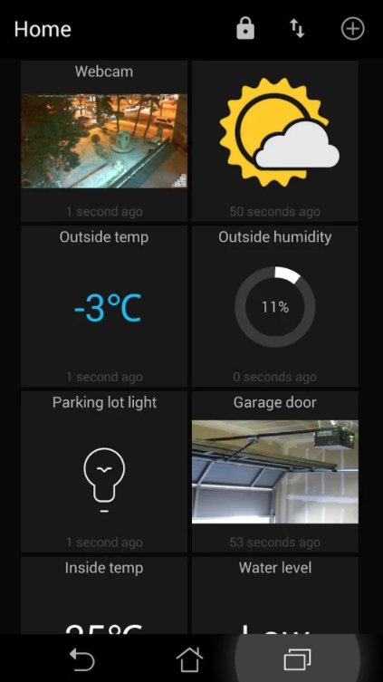
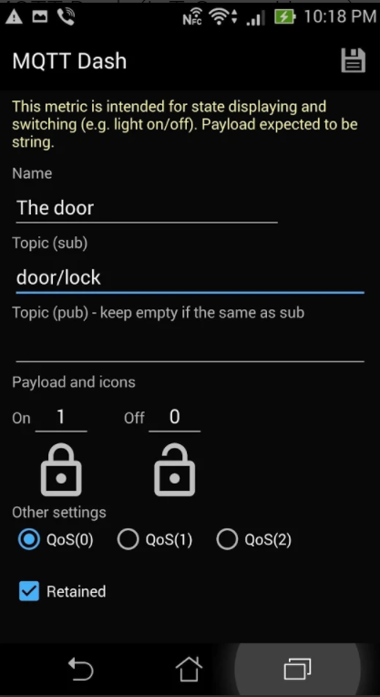
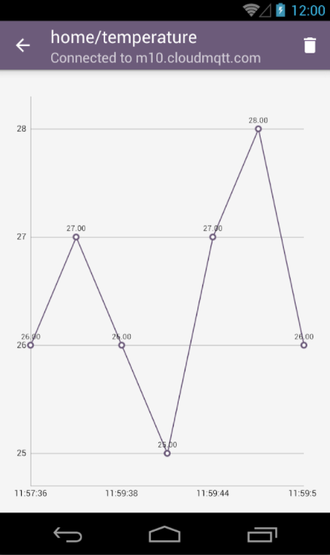
Dashboard Apps
MQTT Dash – Routix software
MQTT Client – Webneurons
Notes:
As mqtt has been around a while now, a small number of android/ios apps have emerged where you can setup mqtt dashboards.

Slide 19
The N4 MQTT Driver
Features
Demo
Notes:
We have seen the theory, now let’s see the practice.

Slide 20
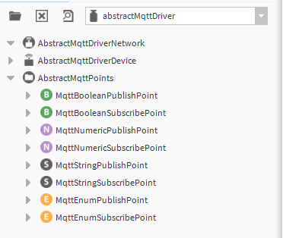
About the Niagara Driver
MQTT Palette
Released Q4 2017
N4.2+
JACE 8000 / Supervisor (Windows)
Limited to 25 devices
IBM Bluemix supports 500 subscribers per connection
1 Device = 1 client connection
No hard limit on points
Remember each publisher / subscriber point = global license capacity
Notes:
The tridium driver was released at the end of last year, and will work with Niagara 4.2 upwards.
As of very recently it is also now part of the standard release image.
It is officially supported for the JACE 8000 or windows supervisors. It is built upon a cross platform java library so linux support is just the formality of official testing
Should work with 4.4 / linux supervisor but just untested.
As you can see in the palette there are publish and subscribe points for each of the 4 standard Niagara types.
The mqtt license feature comes with a 25 device limit. While this sounds like a restriction, in practice you need to remember that a Niagara mqtt device equals 1 client connection.
That could be connections to 25 different brokers or 25 devices to 1 broker. In reality you are unlikely to want many more connections that this in a network. There is no hard limit on points within a device, but bear in mind that each publish or subscribe point will equal to 1 unit of global point capacity.

Slide 21
Configuration Demo
Notes:
What we are looking at here is a free to use online broker called hivemq. when I say free, I think they might block you after your billionth message that day.
Notice the stats on the botton here, millions of messages through the broker that day but the total size of all that data quite small, less than a kb per message. Just the google homepage is around 500kb…………………..

Slide 22
Pros and Cons
Simple adoption - standard Niagara driver model
Built upon a well tested library
Remember it is still v1!
How to handle rich data?
Notes:
So to recap the niagara driver is based upon the niagara driver model so it is simple to wiresheet attach data and events between niagara componennts and mqtt pub/subs
It is based upon the well established paho java library so it has already benefitted from historic development and bug fixing.
However it is just version 1 of the driver and is not the finished article yet. We are currently gathering feedback on the initial driver release to plan what we will include in future updates.
Another thing to consider when using the driver is that while it is sometimes useful to publish numeric values or even enum strings for a status – customers have already given feedback that there will be occasions when you may want every single change of value, or want to take a higher level snapshot view of a building, or combine many values together.

Slide 23
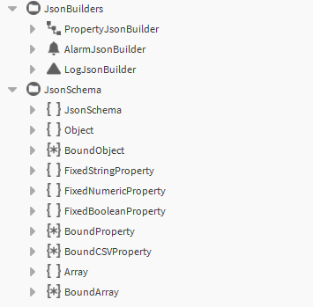
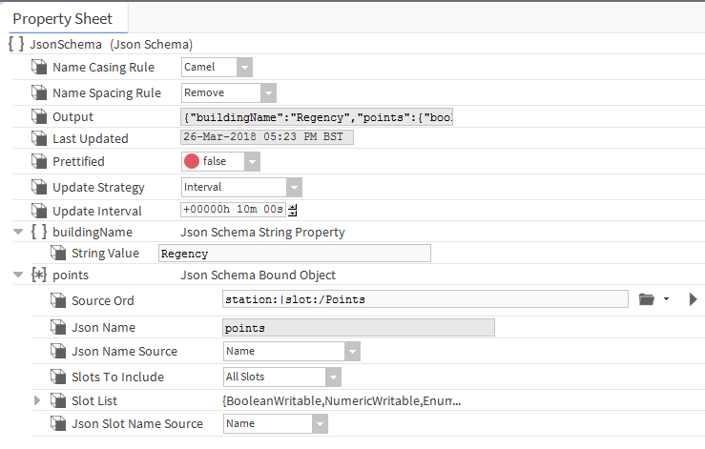
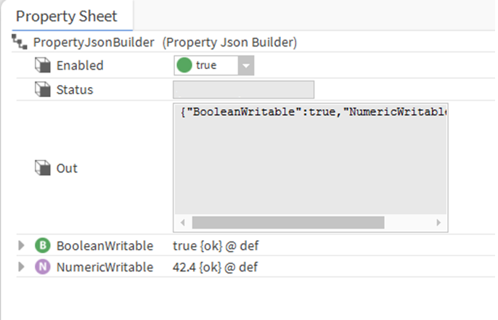
JSON Schemas
{
“time”: “14:45 Mon 16 2018”,
“floor5”: {
“occupied”: true,
“lightLevel”: “55%”,
“temp”: 23.2
}
}
Notes:
If you go anywhere near the workings of a modern web application you will no doubt keep hearing the word JSON. It has become the de facto way of packaging up messages to send from one system to another, and if you are not familiar with it, this is a sample example.
Between these braces you have names of values, a colon and then the actual value. The actual value can be a piece of string text, a Boolean true/false or a number. It can also be another json object nested inside in the case of floor5 here. You can create any structure or depth your application requires. It’s a very simple but powerful structure for carrying data.
While there are libraries within Niagara for developers to create json, there is currently no way of easily integrating this into wiresheets. So you require developers if your external system requires a particular json message format to be sent outbound or to understand some json received inbound. There are json property builder folders and json schema builders. The property builder is special folder you can drop into your station and will construct json for all the point values added underneath.
At the Tridium emea office while we don’t want to put developers out of jobs we are currently working on a prototype toolkit to solve to the former of these problems and make it slightly easier to create json from station components.
It is early days so these still look a bit rough but you can see In one example you are able to drop your components under a PropertyJsonBuilder that is a special folder type, and it’s contents are encoded to json on change through subscription, and supports alarm and history capture. Alarms and histories are also supported.
Another approach we have been working on is a json schema builder which supports the building up of a complex structure, whereby you bind values from anywhere inside your station by choosing ords, supports properties, objects, arrays and csv strings, and allows you to choose from update on cov, on a fixed interval or when an action is fired.
We hope to make progress on this in the coming months to help compliment the mqtt driver.

Slide 24
CoAP
RESTful IOT
Notes:
The 2nd protocol we are going to look at is a new kid on the block called coap

Slide 25
CoAP – Constrained Application Protocol
CoAP
6LoWPAN
IPv6 / UDP
Resource discovery
Peer to Peer Request / Response
State transfer
MQTT
UDP
TCP
IPv6
IP 4/6
6LoWPAN
Notes:
CoAP is a relative new protocol which has been around just 3 – 4 years now.
It is another protocol designed to cope with low power devices on lossy networks but quite different to mqtt it its design.
What is a presenters worst nightmare – it is trying to remember the acronym 6LoWPAN which is ip6 over low power wireless personal area network phew.
What this means is that it uses IP6 (remember many more addresses) to connect low power devices over a wireless protocol.
While mqtt uses TCP, coap uses UDP. I will give you a quick refresher in case you are not aware of the difference here. TCP is connection oriented – a bit like a telephone call your client and server have a persistent conversation going backwards and forwards with lots of error checking. With UDP there is no connection - the error checking is thrown in the bin to allow things to be faster, you broadcast a message to a specific address or all addresses and hope they received it. I would actually tell you a joke about UDP, but you might not get it….
As it is UDP based it supports multicast messaging which makes discovery of other devices possible.
Unlike MQTT this protocol which has this many to many nature, coap is request / response based on a mesh network without a central broker to coordinate things.

Slide 26
CoAP REST
GET coap://localhost:5683/temp
POST coap://localhost:5683/config
<conf>
<firmware>3.5</firmware>
<units>C</units>
</conf>
REST model
URI
Content types; text/xml image/png…
Can proxy over HTTP
CoAP
CoAP
proxy
proxy
HTTP
HTTP
Notes:
The USP for coap in my opinion is that it tries to embrace the best of the conventions of the modern web today.
In particular it implements the REST model of communication.
What that means if you are not familiar, is that when a client talks to a server, the server does not remember any of the conversation between 2 messages. My wife knows what this feels like if she talks to me when there is F1 racing on the tv. We are all familiar with web sessions, for example when logged into amazon it remembers who you are and what is in your basket – there is nothing like that with REST. With REST, all of your resources and operations have a URL a unique web addres to which you send GET requests to read or POST requests to write. All of the conversational state must be included in each message. This leads to far simpler and scalable systems.
This is what CoAP have replicated with GET and POST commands to urls.
Also the protocol supports a limited number of content types such as text/xml or image/png so you can tell the other node how to interpret your data.
One of the unique benefits of this architecture is that you are able to create coap to http proxies so that you can route your local wireless coap messages over the internet to a receiving proxy the other end, making this a very flexible iot solution.

Slide 27
CoAP Other Features
4 Byte fixed header size
Observer Pattern
TCP / SMS
DTLS Security layer
FIXED HEADER
4 Bytes
Token
Optional
Options
0 - Many
PAYLOAD
Optional
OBSERVE=0 /temp
OBSERVE=1 25 C
OBSERVE=2 23.4 C
CoAP
CoAP
CoAP
TCP
SMS
DTLS
IPv6
UDP
Notes:
This is a really quick overview of CoAP but to list some other features
Like mqtt it has a super small fixed header size – 4 bytes in this case with optional tokens for managing asynch conversations and options such as the content type we discussed earlier.
While it does not have the queues of mqtt, it is possible to subscribe to a url on another node, and to receive all changes of value back.
Complimentary standards have been written for coap over tcp or even sms.
As COAP is not TCP based you cannot tunnel over ssl but no worries, the boffins have created an equivalent for UDP

Slide 28
CoAP Use Case
HTTP/1.1
GET https://myproxy/barcamera/lastMotion
HTTP/1.1
POST https://mysite/events/motionDetected
<location>behindHotelBar</location>
NON GET
coap://jace:5683/barcamera/lastMotion
2.05 Content
CON POST coap://myproxy:5683/events/motionDetected
<location>behindHotelBar</location>
CoAP
proxy
HTTP
HTTP/1.1
GET https://mysite/barcamera/lastMotion
Notes:
So for an academic real world use case of how you might harness CoAP
On the left here we have a CoAP network of nodes, and a security camera has detected motion behind the hotel bar out of hours.
An xml message is posted to our proxy server which is then forwarded across the internet to a web server. Notice that very little needs to be translated between a coap and http message.
Our downstream clients used by the security team talk http to this server and the app makes a request of an image of the last motion detected.
This is proxied back to our coap network, this time a GET request
And our culprit has been detected.

Slide 29
More Mature
MQTT devices get more beauty sleep?
Discovery
Many to Many Messaging
Only 2 QoS levels
REST = easier integration
Notes:
We could honestly for a long time about the differences between protocols, but I have selected just the few I think are important.
Mqtt is more mature, it has been around longer and is more supported, it even has a niagara driver.
Discovery over UDP is far more flexible that wildcard subscriptions of mqtt
Mqtt supports many to many messaging across the internet in a far more simple scalable fashion than using udp with proxies.
However the restful architecture may be a better fit when slotting into existing integrations
It is likely that mqtt drivers are more battery efficient, coap devices being UDP will receive a lot of broadcast messages which are not intended for them.
Simpler to Integrate – NAT
The client makes the connection
Local M2M Comms – no brokerHTTP Proxy complexity

Slide 30
AMQP
The all rounder
Notes:
AMQP is the final protocol we will examine

Slide 31
AMQP
Publishers
Publish 22º
TEMPS
TEMPS.BLD1.ROOM1
Advanced Message Queueing Protocol
Publisher / Consumer model
with exchanges and queues
Routing & Binding keys
Messages shared by consumers round robin style
Exchange
22º
22º
22º
TEMPS
Broker
Queues
TEMPS.*.ROOM1
TEMPS.#
#
Consumers
Notes:
For amqp – think mqtt plus plus
It is another publisher/consumer based model with a broker, but with more complexity. Instead of just topics, amqp has the further concept of exchanges and queues between the publisher and consumer.
Each message specifies 2 values it’s target exchange which you can think of as being the topic, it has a name here TEMPS. But it also specifies a routing key which dictates which queues this message may get copied to.
Clients can then attach queues to the exchange with an associated binding key. Each message whose routing key matches this queues binding key receive the message. Like mqtt there is support for special characters
Any number of consumers may link themselves to queues. The important point to remember here is that the consumers share that queue, if you attach 2 consumers to the same queue then they will receive alternate messages.

Slide 32
AMQP Exchange Behaviour
Direct
Exact key matches only – no wildcards
Topic
Wildcard support # and *
Fanout
Keys ignored

Slide 33
AMQP - Topologies
Fanout
Fanout
Many to many
Round Robin – load balancing
Priority queues
Topic
#
Notes:
The combination of the different exchange behaviours and different bindings allows you to setup a vast array of different architectures between your publishers and consumers.
For example a many to many application where you might use a fanout exchange to deliver data to multiple queues allowing parallel processing of the same message. This might be delivering data to all clients subscribed to the data through their phone app.
Or you may choose to use load balance data in a round robin manner with multiple consumers attached to the same queues using.
Or a mixture of approaches is also possible

Slide 34
AMQP - Topologies
Connections
Containers
Groups of nodes
Nodes
Publisher / Consumer / Queue
Connections
Comms between containers / security
Sessions
Multiple per connection / bidirectional
Links
Join 2 nodes – multiple per sessions
One way
Link state is recoverable / resumable
Links
Containers
Connection
Session
Notes:
In terms of connections in amqp, connections are held between containers.
Containers are logical groups of nodes which are your publishers / consumers or queues etc
Your containers maintain connections for communication, the connection is where security is applied
Within connections you have sessions which supports a multiplex 2 way conversation between links.
Links are where the messages between nodes take place, you can have multiple per session, and the link is stateful in that the current state of the conversation between nodes may be recovered and resumed.

Slide 35
Flow Control
Connection
Max frame size
Max number of channels
Session
Maximum frame count
Link
‘Credits’ per link limits number of messages
Connection
Session
Notes:
In all real world applications there are constraints imposed – be it licensing costs / bandwidth / cost of using that bandwidth.
Amqp has the concept of flow control built into the protocol at all levels.

Slide 36
AMQP – Other features
Exchanges
durable / temporary / auto delete
QoS – 3 level
AMQP
SSL
Message expiry
TCP
IP 4/6
Reply to:
SASL negotiation
Digest / SCRAM / Kerberos ….
Notes:
AMQP is quite a big topic in itself and too much to cover in full detail in 10 minutes, so I will simply list some of the features that make it standout.
Exchanges can be setup so that they are durable (survive broker restart) or temporary. They can also be setup to auto deleted themselves when the last link disconnects.
All 3 qos exist – at most once, at least once at most once.
Mime types and content encoding is supported
The message properties can include expiry times to define how long messages sit in queues
You can specify different nodes to reply to for a given message
Tls security is available but you can choose to apply TLS before or after the amqp handshake between containers
Finally SASL negotiations is avalilable meaning 2 containers can select the highest shared authentication mechanism include digest / scram etc.

Slide 37
Libraries and Brokers
Client libraries – C / Java / C++ / Node
Open Source Brokers
RabbitMQ
Apache ActiveMQ
Used by Sentience IoT platform
Notes:
Support for amqp is growing fast and is pretty much at the same level now as mqtt despite being a newer technology
There is cross language client support on github and apache
In terms of brokers there are application such as rabbitmq which an open source message broker written in erlang that has really championed amqp
Apache activemq is another similar broker written in java and designed to be highly clustered, we saw all 3 of these listed in the mqtt slides also.
While there are no current plans in progress for a Niagara driver – if you have used Nigara Backup as a service then you have indirectly used AMQP

Slide 38
MQTT more battery efficient *
Guarantees message order
Message Fragmentation
MQTT V5
Flow Control / Expiry
Better Security Options
Better between 3rd parties
* https://www.researchgate.net/publication/282914203_A_comparative_evaluation_of_AMQP_and_MQTT_protocols_over_unstable_and_mobile_networks
Notes:
So back to the protocol ruckus.
6- While mqtt was written by IBM for the IOT low powered devices world, AMQP was conceived in the finance industry to allow financial systems to exchange trading data. For that reason it has been designed from the outset to cope with very different systems talking to each other.
I should also point out at this juncture however, that some features amqp has over mqtt are arriving in mqtt v5.
================
https://lists.oasis-open.org/archives/amqp/201202/msg00086/StormMQ_WhitePaper_-_A_Comparison_of_AMQP_and_MQTT.pdf
AMQP permits almost any form of messaging including classic message queues, roundrobin, store-and-forward and combinations thereof.
AMQP as the asynchronous complement to HTTP
MQTT requires short user names and short passwords that do not provide enough entropy in the modern world. It has made these part of the protocol itself, so any change in policy, or security weakness, requires a new protocol version. AMQP uses SASL mechanisms, allowing organisations to choose the security that matters to them (e.g. Kerberos V5) without protocol change. It also supports a common security practice, the notion of proxy security servers, i.e. that the message queuing server (broker) is not the same as that providing the termination of the security layer(s). This allows organisations to use gatekeepers, nested firewalls, etc
MQTT does not permit fragmentation of messages, making it difficult to transmit large messages with constrained memory devices, however.
To MQTT and CoAP, a message is opaque. Notionally, this is a good thing; but it limits the infrastructure to nothing more than transmission from sender to receiver. In AMQP, they are not. In practice, messages are not solely transmitted from a client to a receiver. They may be redirected or routed. They may pass through another pair of hands.
Amqp general purpose message broker
Mqtt used to deliver data to a control application, amqp used within your application?
MQTT is designed to be of use for many small, relatively dumb devices sending small messages on low-bandwidth networks. AMQP, on the other hand, is designed to provide the full vibrancy of messaging scenarios that have been seen in the last 25 years. MQTTʼs design goals are a subset of its intended uses. In particular, MQTT very much sees the network between the involved parties as a controlled, near private infrastructure; AMQP, on the other hand, is designed assuming it is in use between parties under different controls and who use network and infrastructure resources outside of those partiesʼ control.

Slide 39
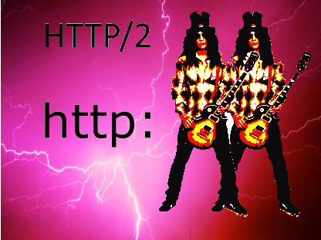
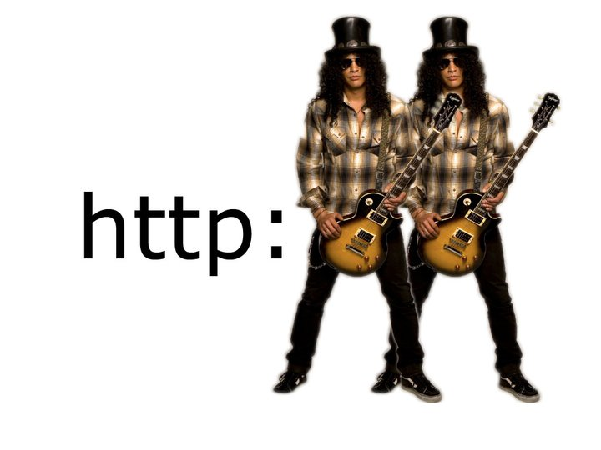
What about HTTP Slash Slash?
Battery Efficiency
http://stephendnicholas.com/posts/power-profiling-mqtt-vs-https
Scaling / Discovery / Error handling requires:
Notes:
So what about our old friend. HTTP has been a staple of internet communications for years and will be for years to come.
The simple fact is that not only are the new IOT protocols are far more battery efficient per message that http
But also the wealth of features we have seen that enable scaling / discovery / qualities of service / message expiry to name a few, while all possible with http – they typically require a developer or 7 to make them possible.
This is not the end of the story however, HTTP 2 is now on the scene which is far more efficient, but it is still gaining momentum and may only help with the first of these points here.
====================
http://tutorials.jenkov.com/iap/why-http2-and-websockets-are-not-enough.html
One study which compared battery life between mqtt showed that mqtt was superior
HTTP2 much faster and allows server push but still a semantic difference – not many to many, no error handling

Slide 40
Travelling (Tridium) Salesman
Real World Use Case
Notes:
One of the most common problems given to university software engineering students is the travelling salesman problem, how to find the most efficient route between various points.
Today in our Stilton Hotel we will be facing a far more difficult prospect - the Travelling Tridium Salesman .. Because being in the industry that we are in, our salesmen are stringent to the point of obsession when it comes to hotel room temperature.

Slide 41
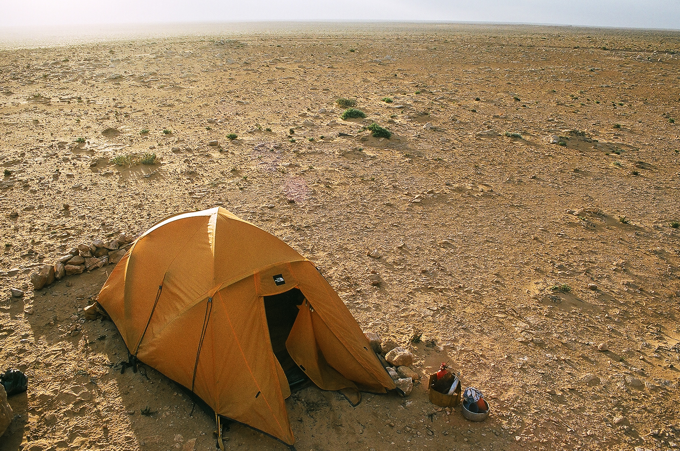
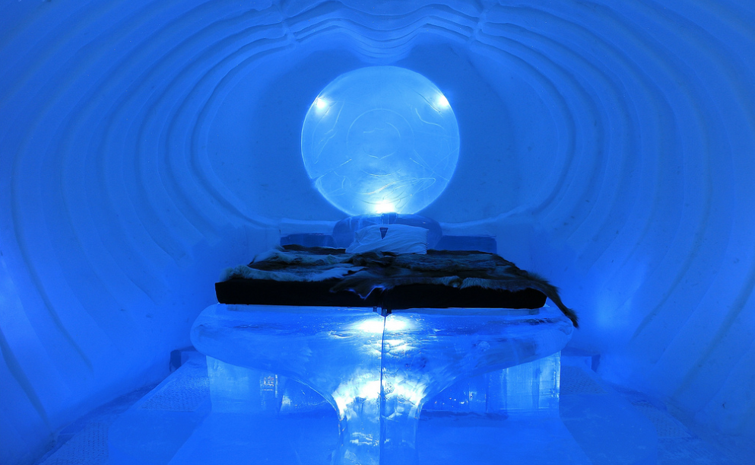
Notes:
Here is where our EMEA salesman Paul Warnes likes to sleep, while Paul Price is more comfortable with this hotel room.

Slide 42
Micros Driver
Oracle Subsidiary
Fidelio Property Management System
Points = Hotel Rooms
Occupancy
Guest Check In/Out events
Pre-arrival room settings
Minibar / TV rights
Notes:
This gives us the opportunity to demonstate the mqtt driver in use in a hotel.
At tridium emea we have created a driver which integrates with the micros Fidelio hotel booking system. This allows you to represent the occupancy of a hotel room which has it’s own micros proxy point, and respond to pre arrival, check in and check out events to heat/cool and light your rooms as you see fit. As a bonus it also lets you react to the customers tv or minibar rights.

Slide 43
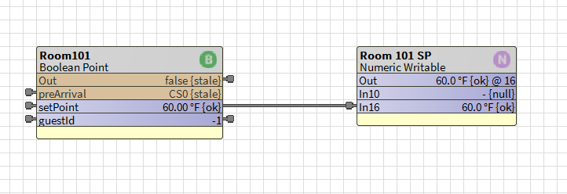
Demo

Slide 44
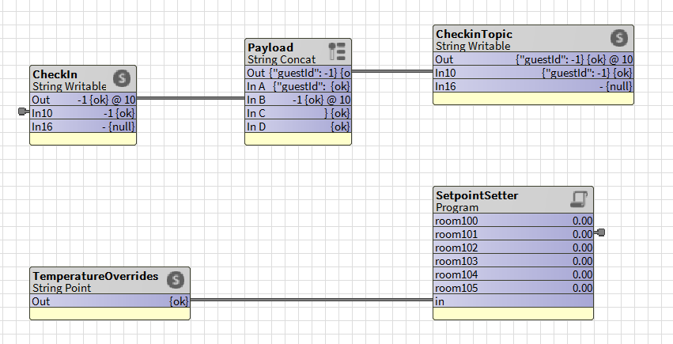
Demo
Convert to JSON
{ “guestId”: ……}
MQTT Publish /stiltonhotel/checkin
Micros guest id
Links to Room Setpoint
MQTT Subscribe /stiltonhotel/tempOverride
{“room”: 101, “temp”: 74}

Slide 45
Demo
https://stiltonHotel.eu-gb.mybluemix.net/

Slide 46
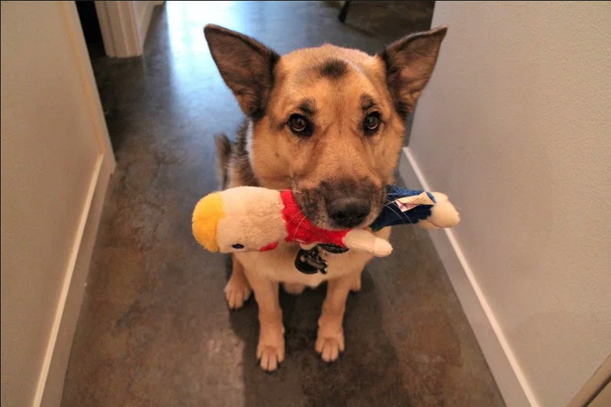
‘Real World’ Use Cases
https://hackaday.com/2018/01/05/bark-back-iot-pet-monitor/
Automatic dog shushing
Logs events to CloudMQTT

